Slide 1


Machine Learning
Hemant Saggar
Electrical and Computer Engineering Department
hsaggar@ucla.edu
Los Angeles Computing Circle
July 16-17, 2018

Slide 2
In This Lecture
What is Machine Learning
Definition. Examples. History. Current. Future.
Types of Problems solved by Machine Learning
A Binary Classification Example
Intuition behind and setting up the problem
Supervised Learning Approaches
Naïve Bayes classifier
Linear and Logistic classifiers
Support Vector Machines
Neural Networks
Unsupervised Learning
K-means
Dimensionality reduction
Projects
Monkey hand movement to the target.
Digit classification from images into 0 to 9 using Naïve Bayes classifier.

Slide 3
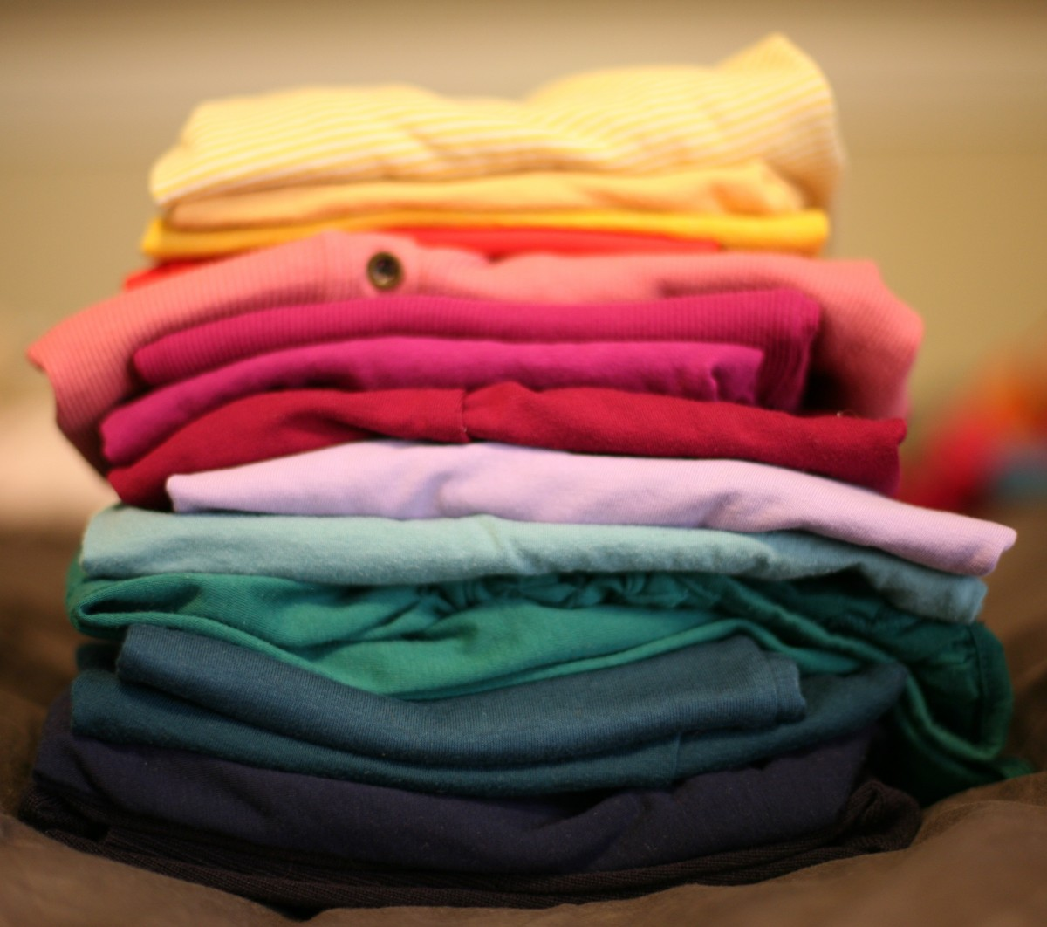
What is Machine Learning: An Example
A Laundry company has five washing machines for washing different color clothes. The company puts a Laundry Sorting algorithm in charge of separating the clothes into different piles for each machine. Where should these clothes go?
How?
WHITE | BLACK | RED | GREEN | BLUE

Slide 4
Why can’t it be simple if-then rules?
But why cannot we just hard-code some simple rules in the computer?
Why can’t we use our understanding to explicitly tell the computer what goes in the red pile, what goes in the blue pile and so on… ?
Good point. The reason is:
So many rules.. Little bit of color->can’t go in white. Some colors leech more, some less. Low intensity colors mixed together okay, high intensity no. Decisions are cloth dependent…Towels can get lightly tainted but shirts no!
Why to use Machine Learning:
If the problem is well understood and there is a compactly representable relationship between the input and the output, then we should use that in the computer. No need for ML ☺.
In many problems, the relationships are either just too many to write down as if this then that OR not even understood properly.
Machine learning saves a lot of our time and effort in hand crafting these rules by learning from given examples.
With enough examples computers can self create arbitrarily complex rules and learn to see, walk, talk, read etc. (like a kid for now ☺).

Slide 5





Machine Learning: Training with examples
First Train the Machine with Examples.
Represent all the inputs as points in a coordinate (x,y,z,…) system. (Eg ?)
Define a function representing a score for each class for each input. (Eg.?)
Classify/assign class to input to the maximum scoring class.
WHITE | BLACK | RED | GREEN | BLUE
Initial learned boundaries

Slide 6



How more training improves generalization
So now the machine has learnt a basic rule (score based model) to classify into 5 classes.
Test if the machine classifies new (unseen) clothes correctly.
x
?
Learning accurate boundaries between color classes i.e. where red stops and blue starts.
?
RED | --- | BLUE

Slide 7


Learning complex class rules through training
So now the machine has learnt a basic rule (score based model) to classify into 5 classes.
Test and see if the machine works on new (unseen) clothes.
Learning how to recognize special cases like between white and color.
WHITE | --- | RED
Boundaries after many
Training iterations.

Slide 8
Training and Testing Set
Usually there is a fixed training set. But for our laundry sorting system, if we can manually indicate the correct responses, then we can increase the size of the training set. This usually helps improve performance.
But, the algorithm is never tested on the training set (to avoid bias). It is tested (once at the end) on new examples to estimate its performance.

Slide 9
Ingredients of a Machine Learning System
Our Laundry Sorting Algorithm:
Makes a decision or classification on a new input. (where to put the cloth)
Input data is represented in terms of its features (ratio of each color in the cloth).
Wants to minimize (or maximize) an objective and we can measure its learning performance over a random sample of input (total mismatched color in all washing machines on average).
The learning performance improves as the algorithm sees more correctly and incorrectly classified examples (operator alerts the computer if he finds a cloth in the wrong pile).

Slide 10
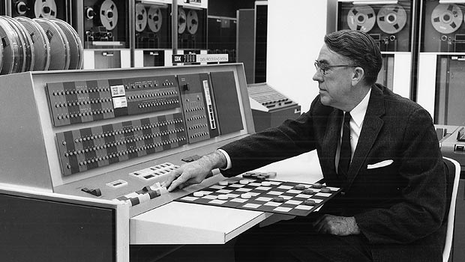
What is Machine Learning?
http://www-03.ibm.com/ibm/history/ibm100/us/en/icons/ibm700series/impacts/
Arthur Samuel (IBM, Stanford Professor) (pioneer and coined the term Machine Learning in 1959)- “Field of study that gives computers the ability to learn without being explicitly programmed“
Tom Mitchell (CMU Professor)- “A computer program is said to learn from experience E with respect to some class of tasks T and performance measure P if its performance at tasks in T, as measured by P, improves with experience E.”
Main idea: software/algorithms that can improve on a
task based on data and previous experience.

Slide 11
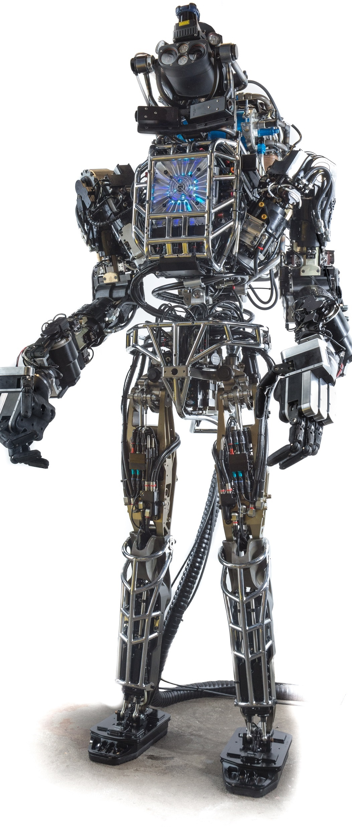

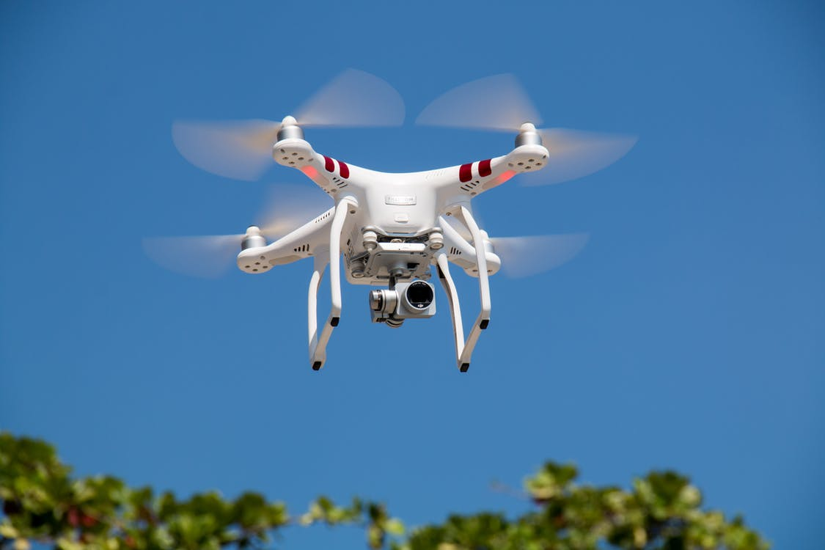
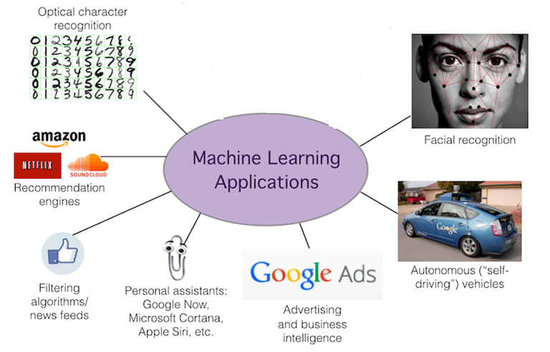
Applications of Machine Learning
Speech recognition
Semantic analysis
Drone navigation
Self learning robots

Slide 12
Past, Present and Future of Machine Learning
Machine Learning is a sub-branch of Artificial Intelligence that focuses on how machines can learn rather than on end to end intelligent systems.
Since the invention of computers, scientists wanted computers to be able to imitate humans in skills, such as recognize objects, understand speech, think and give cohesive answers, play games like chess etc.
In 1952, Arthur Samuel wrote the first computer program that could play checkers and improve with experience.
In 1957, inspired the by the human brain, the first Artificial Neural Network called the Perceptron was invented by Frank Rosenblatt. It could do binary classification.
Research stagnated in the 70s because the neural networks were not thought to be powerful enough.
In 80s it was rediscovered how to train neural networks using backpropagation.
With better computers and much more data, Machine Learning progress leapfrogged.

Slide 13
Past, Present and Future of Machine Learning
Numerous learning algorithms have been invented in the last 30 years that are more powerful than the previous in learning complex patterns in data.
Some of the recent algorithms that have been invented and are being used are
Support Vector Machines
Decision Trees and Random Forests
Convolutional Neural Networks
Recurrent Neural Networks
Deep Neural Networks

Slide 14
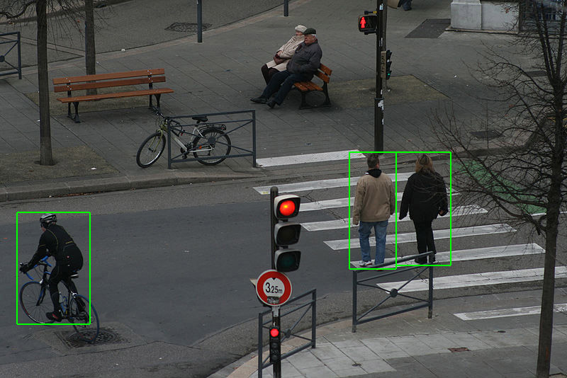

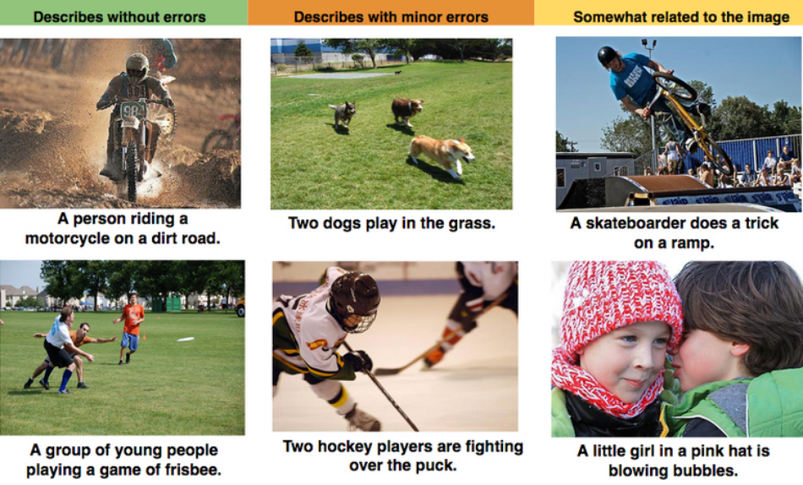
Past Present and Future of Machine Learning
These have allowed these algorithms to do things like
Detect pedestrians and cyclists from video in real time to avoid crashes.
Detect distant galaxies and new space objects from telescope images.
Caption Images and Videos automatically.
Read out the nearby world through glasses for the blind [link].
Play and win games like chess, go, Jeopardy against the best players [link].

Slide 15
Future Possibilities of Machine Learning
Can you suggest some practical uses of Machine Learning and Artificial Intelligence?
Healthcare/Biology:
Helping cure diseases like cancer by massive data analysis and modeling.
Personalized medicine based on individual genome.
Understanding how billions of neurons in human brain communicate.
Agriculture:
Reducing pesticide use by only giving sufficient enough to kill the weeds.
Climate:
Better weather and storm prediction.
Space:
Self driving airplanes
Self driving extra-Solar system rovers

Slide 16
Need of Some Caution
Machine Learning skills is more than just programming. It uses knowledge from fields like probability, statistics, linear algebra, calculus, physics, optimization. These skills become more important the deeper you go into the field so please learn them.
Use the simplest solution that gets your job done… e.g. Don’t use Machine Learning to add two numbers ☺ . Use a calculator.
Use your skills wisely and for good. Remain ethical.
Keep the privacy of people’s data in mind when using it. Ask permission first and remember that the results may affect them (in things like ad targeting, military surveillance, fake news etc..). See 4.

Slide 17
In This Lecture
What is Machine Learning?
Types of Learning
Applications / Real-Life Examples
Overview of Various Approaches
Detailed View of a Few Approaches

Slide 18
Types of Learning
1. Supervised Learning (task driven)
Training data (example) set is well-labeled with the desired output class.
Examples
Classification
Email spam detector
Facial recognition / thumbprint recognition
Speech recognition (Siri, Alexa, etc
How Siri learns a new language https://www.reuters.com/article/us-apple-siri-idUSKBN16G0H3
Image classification (MNIST/CIFAR/ImageNet)
Prediction
Housing price estimate (Zillow)
Stock market
Medical Diagnosis
Notes:
Data is represented as a point/vector in a feature-space.
Training: (when we mark spam/not spam we provide labeled examples to learn).
(trained on your own face/thumbprint many times (different rotations) ).
.)(data collected by people recording passages and giving the transcription to Siri).
MNIST 70k dataset, CIFAR10/100 dataset 60k images

Slide 19
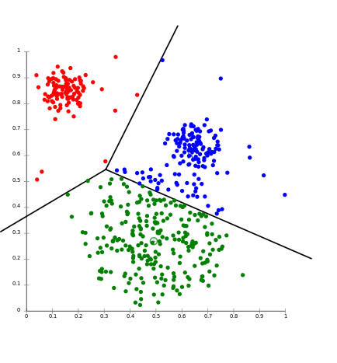
Types of Learning
2. Unsupervised Learning (data driven-exploratory)
No desired output label is given to the training data.
Can be used to find hidden patterns/structure in data.
Examples
Clustering
Shoppers into similar behaviors
User modeling for marketing
Recommendations (Netflix, Pandora, etc.)
Anomaly Detection
Credit card fraud / Banking fraud
Network Attack Detection
Association Rule Learning
Purchase buns + butter = also purchase hamburger patty

Slide 20
Types of Learning
3. Reinforcement Learning (feedback driven)
Interacts with dynamic environment.
Receives positive and negative feedback.
Examples
Complex board games (chess, go, etc.)
Why not tic-tac-toe?
Video games
Self-driving cars / drones
Robots learning to walk, adapt to environment

Slide 21
In This Lecture
What is Machine Learning?
Related Mathematical Fields
Types of Learning
Details of Types of Learning
Detailed View of a Few Approaches

Slide 22
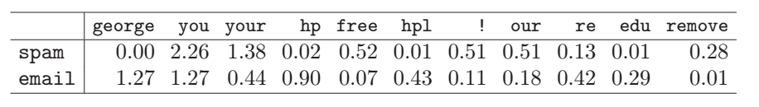
Classification
One type of application is classification.
A popular example is text classification. Email clients have to decide whether an email is
1. spam
2. not spam
This is an example of a classification task. What does the client use to make the decision? Data!
The table below shows % of words/characters in an email message. Some words are found a lot in spam and not in non-spam mail:
Elements of Statistical Learning, Second Edition

Slide 23
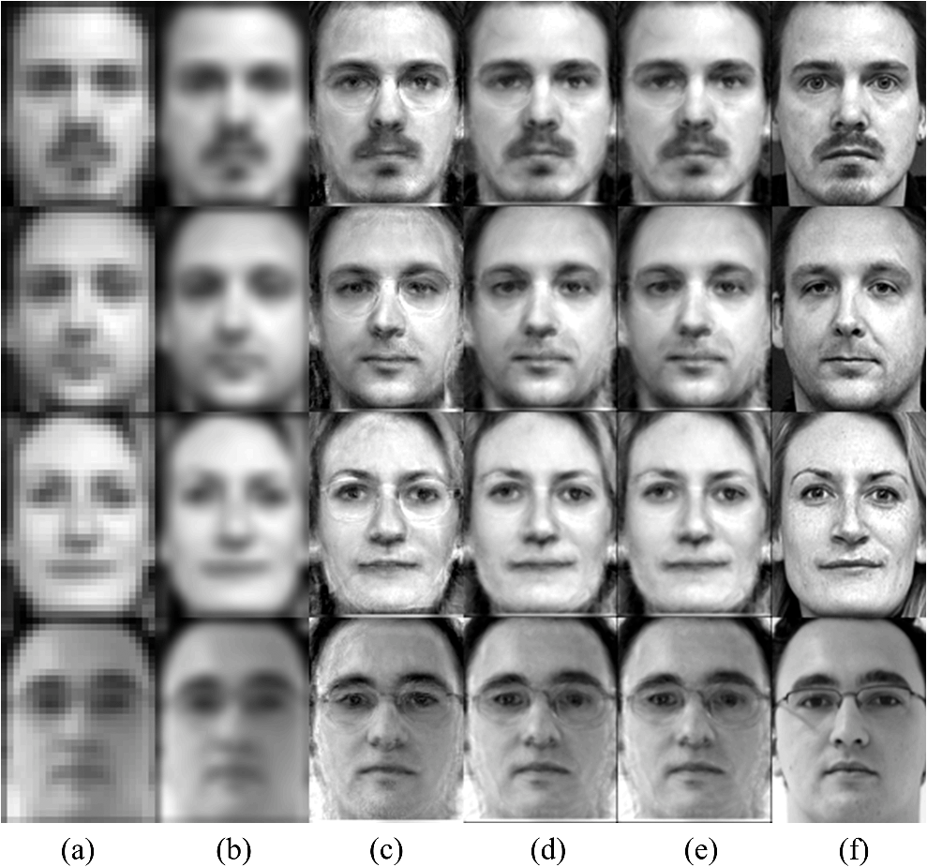
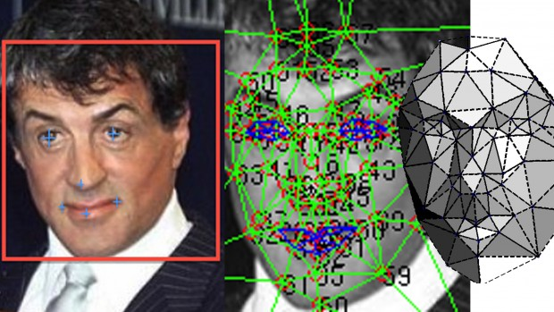
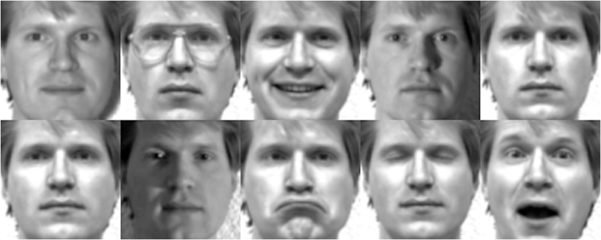
Classification
Also common: facial recognition:
Think of a security system that has a database of employee photos. Each time a person enters the building, the classifier examines a snapshot.
Goal: identify the current person as one of the employees, or an unknown person.
Challenge: facial portraits vary a lot.

Slide 24
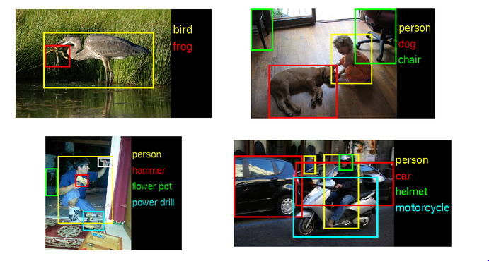
Classification
Image recognition attempts to identify what is in the picture
Try this demo:
http://www.clarifai.com/demo
What images did you get tagged correctly?
What didn’t work?

Slide 25
Automatic Translation
Another task is to translate documents
We have lots of data to start with: thousands of manually translated documents are available
Try it with translate.google.com
Does much better than just a word-for-word literal translation
Soldats de ma vieille Garde,
Je vous fais mes adieux.
Depuis vingt ans, je vous ai trouvés constamment sur le chemin de l’honneur et de la gloire. Dans ces derniers temps, comme dans ceux de notre prospérité, vous n’avez cessé d’être des modèles de bravoure et de fidélité.
Avec des hommes tels que vous, notre cause n’était pas perdue. Mais la guerre était interminable ; c’eut été la guerre civile, et la France n’en serait devenue que plus malheureuse. J’ai donc sacrifié tous nos intérêts à ceux de la patrie ; je pars. Vous, mes amis, continuez de servir la France.
Soldiers of my Old Guard,
I bid you farewell.
For twenty years, I found you constantly on the path of honor and glory. In recent times, as in those of our prosperity, you have ceased to be models of courage and fidelity.
With men like you, our cause was not lost. But the war was endless; it would have been civil war, and France would become more miserable. So I sacrificed all our interests with those of the country; I leave. You, my friends, continue to serve France.

Slide 26

Prediction/ Regression
The first examples we gave were classification applications
The task was to classify some data as belonging to a category
Translation was different: the goal was to produce a different output for each possible input. This is a prediction task.
Prediction is one of the most important and powerful applications for machine learning.
Example: economic decisions. How much revenue is received per dollar of advertising spent?
Can you think of other examples?

Slide 27

Classification versus regression
If the output we’re producing from our algorithm is discrete, the problem is classification
Discrete: takes values in a finite set
Binary classification: generate a 0/1 or yes/no output
If the output we’re producing is continuous, we’re performing regression
The output could be anything.
Fundamental task is linear regression:

Slide 28
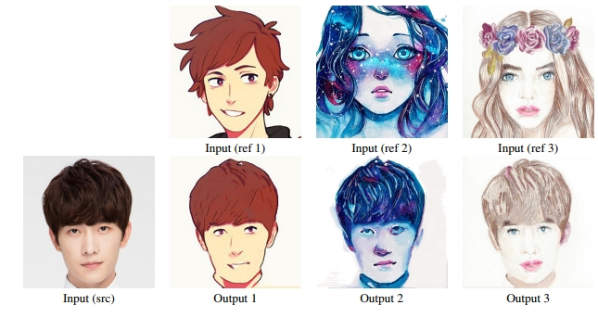
Fun Example 1: Picture Stylization (Deep Learning)
“Supplemental Material for “Visual Attribute Transfer through Deep Image Analogy ” – Jing Liao, et al. (Microsoft Research)
https://liaojing.github.io/html/data/analogy_supplemental.pdf
Can render image A in the style of image B!
Good reference: https://handong1587.github.io/deep_learning/2015/10/09/fun-with-deep-learning.html

Slide 29
Fun Example 2: Robotics
BRETT: Berkeley Robot for the Elimination of Tedious Tasks
https://www.youtube.com/watch?v=JeVppkoloXs
Not preprogrammed with knowledge how to accomplish specific tasks.
Starfish Walking Robot
https://www.youtube.com/watch?v=ehno85yI-sA
Taught itself to walk.
Google DeepMind AI taught itself how to walk.
https://www.youtube.com/watch?v=gn4nRCC9TwQ
https://deepmind.com/blog/producing-flexible-behaviours-simulated-environments/#gif-90
Boston Dynamics
https://www.youtube.com/watch?v=4PaTWufUqqU
https://www.youtube.com/watch?v=fRj34o4hN4I

Slide 30
Fun Example 3: MarI/O
Uses a simple Neural Network to play Mario.
No concept of what any button does, except that going to the right = more points.
www.youtube.com/watch?v=qv6UVOQ0F44&
More levels:
www.youtube.com/watch?v=iakFfOmanJU
Same setup for Mario Kart
www.youtube.com/watch?v=iakFfOmanJU

Slide 31
In This Lecture
What is Machine Learning?
Related Mathematical Fields
Types of Learning
Overview of Various Techniques
Detailed View of a Few Approaches

Slide 32
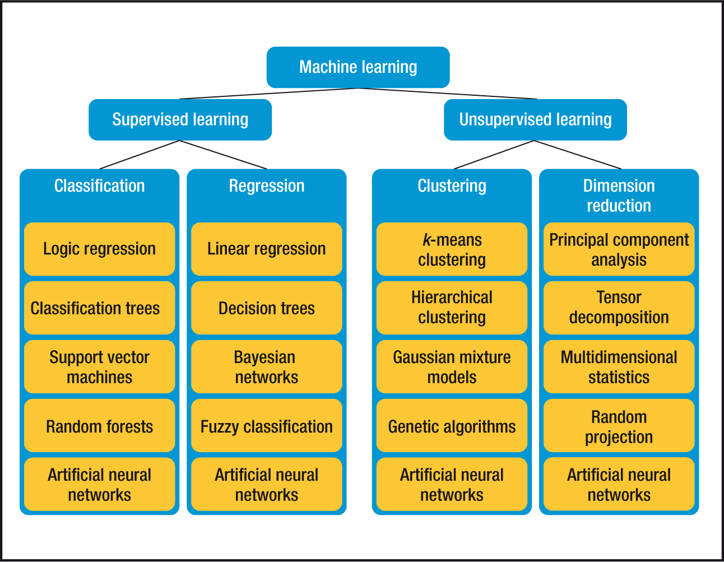
What Machine Learning Techniques Exist?
Source: IEEE Computer Science

Slide 33
How to choose the Best Algorithm?
Very complicated. This is why data scientists are in high demand in the industry.
Can’t just throw data at the computer.
It is a lot of trial and error but different communities (like computer vision, natural language processing) have their own best practices.
We briefly look at a simplified flowchart.
This is a interesting read https://blogs.sas.com/content/subconsciousmusings/2017/04/12/machine-learning-algorithm-use/#prettyPhoto

Slide 34
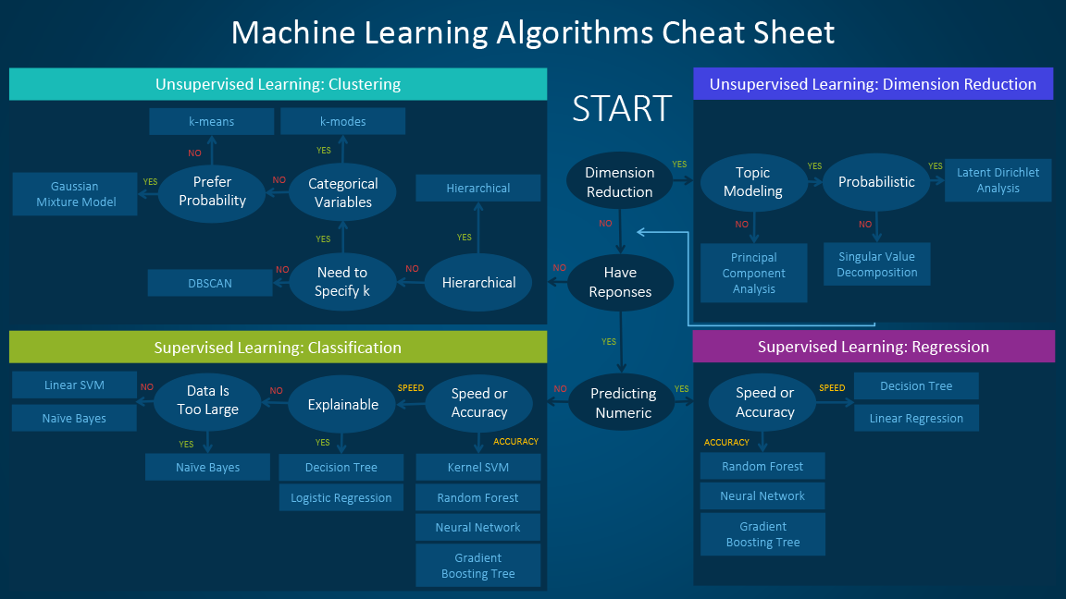
How to Choose the Best Algorithm

Slide 35
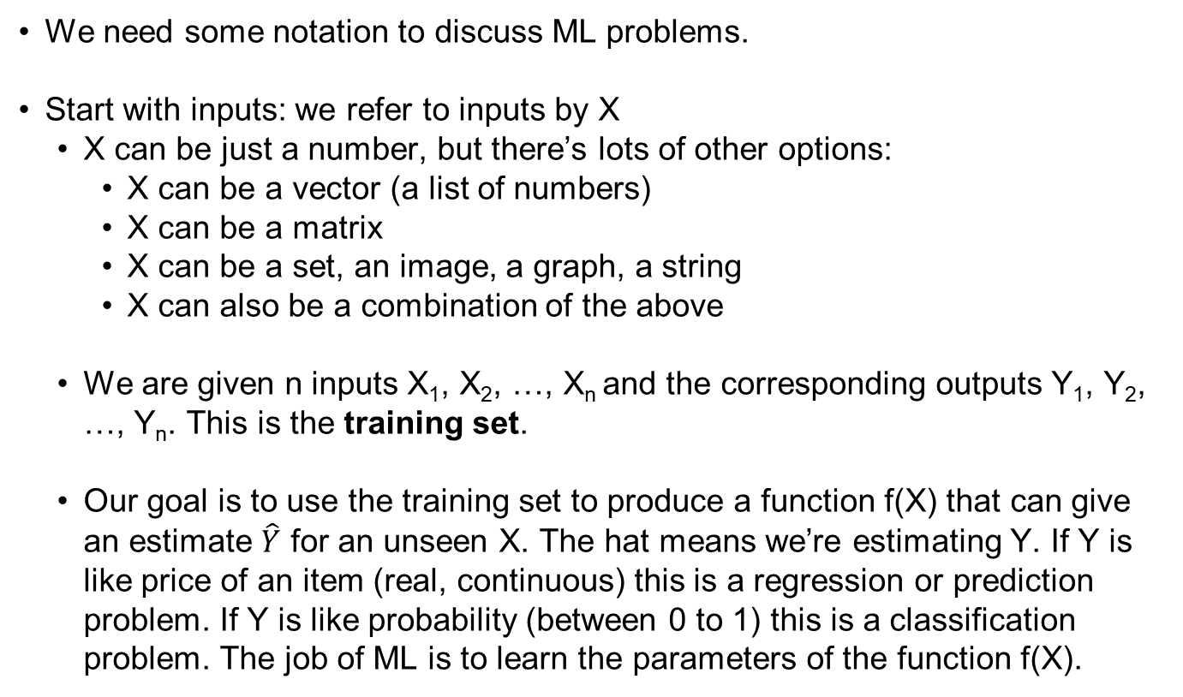
Elements of a ML problem: notation
We need some notation to discuss ML problems.
Start with inputs: we refer to inputs by X
X can be just a number, but there’s lots of other options:
X can be a vector (a list of numbers)
X can be a matrix
X can be a set, an image, a graph, a string
X can also be a combination of the above
We are given n inputs X₁, X₂, …, X_{n} and the corresponding outputs Y₁, Y₂, …, Y_{n}. This is the training set.
Our goal is to use the training set to produce a function f(X) that can give an estimate $\hat{Y}$ for an unseen X. The hat means we’re estimating Y. If Y is like price of an item (real, continuous) this is a regression or prediction problem. If Y is like probability (between 0 to 1) this is a classification problem. The job of ML is to learn the parameters of the function f(X).

Slide 36
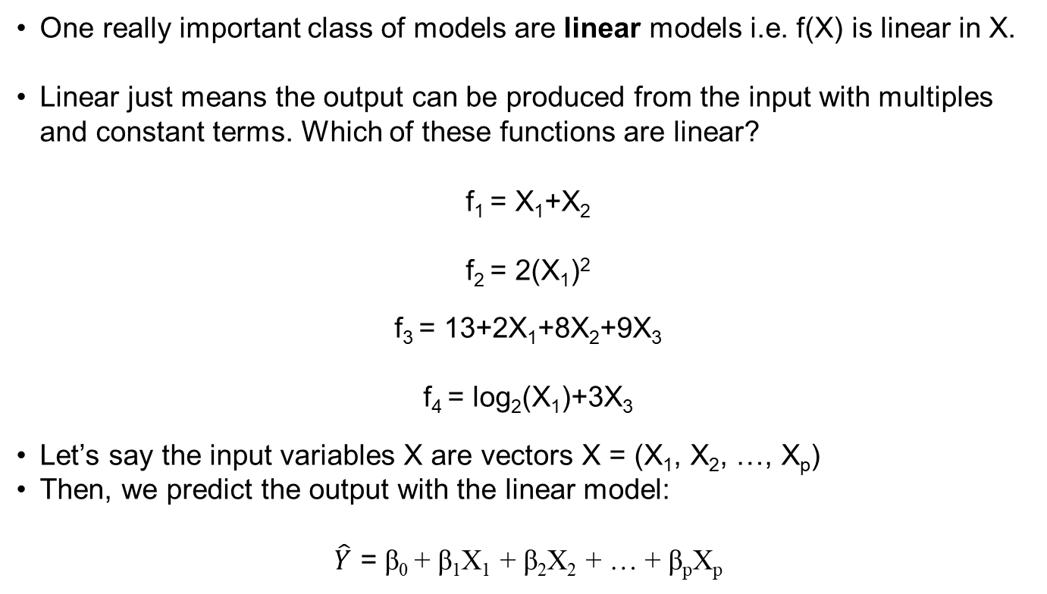
Linear Prediction
One really important class of models are linear models i.e. f(X) is linear in X.
Linear just means the output can be produced from the input with multiples and constant terms. Which of these functions are linear?
f₁ = X₁+X₂
f₂ = 2(X₁)²
f₃ = 13+2X₁+8X₂+9X₃
f₄ = log₂(X₁)+3X₃
Let’s say the input variables X are vectors X = (X₁, X₂, …, X_{p})
Then, we predict the output with the linear model:
$\hat{Y}$ = β₀ + β₁X₁ + β₂X₂ + … + β_{p}X_{p}

Slide 37
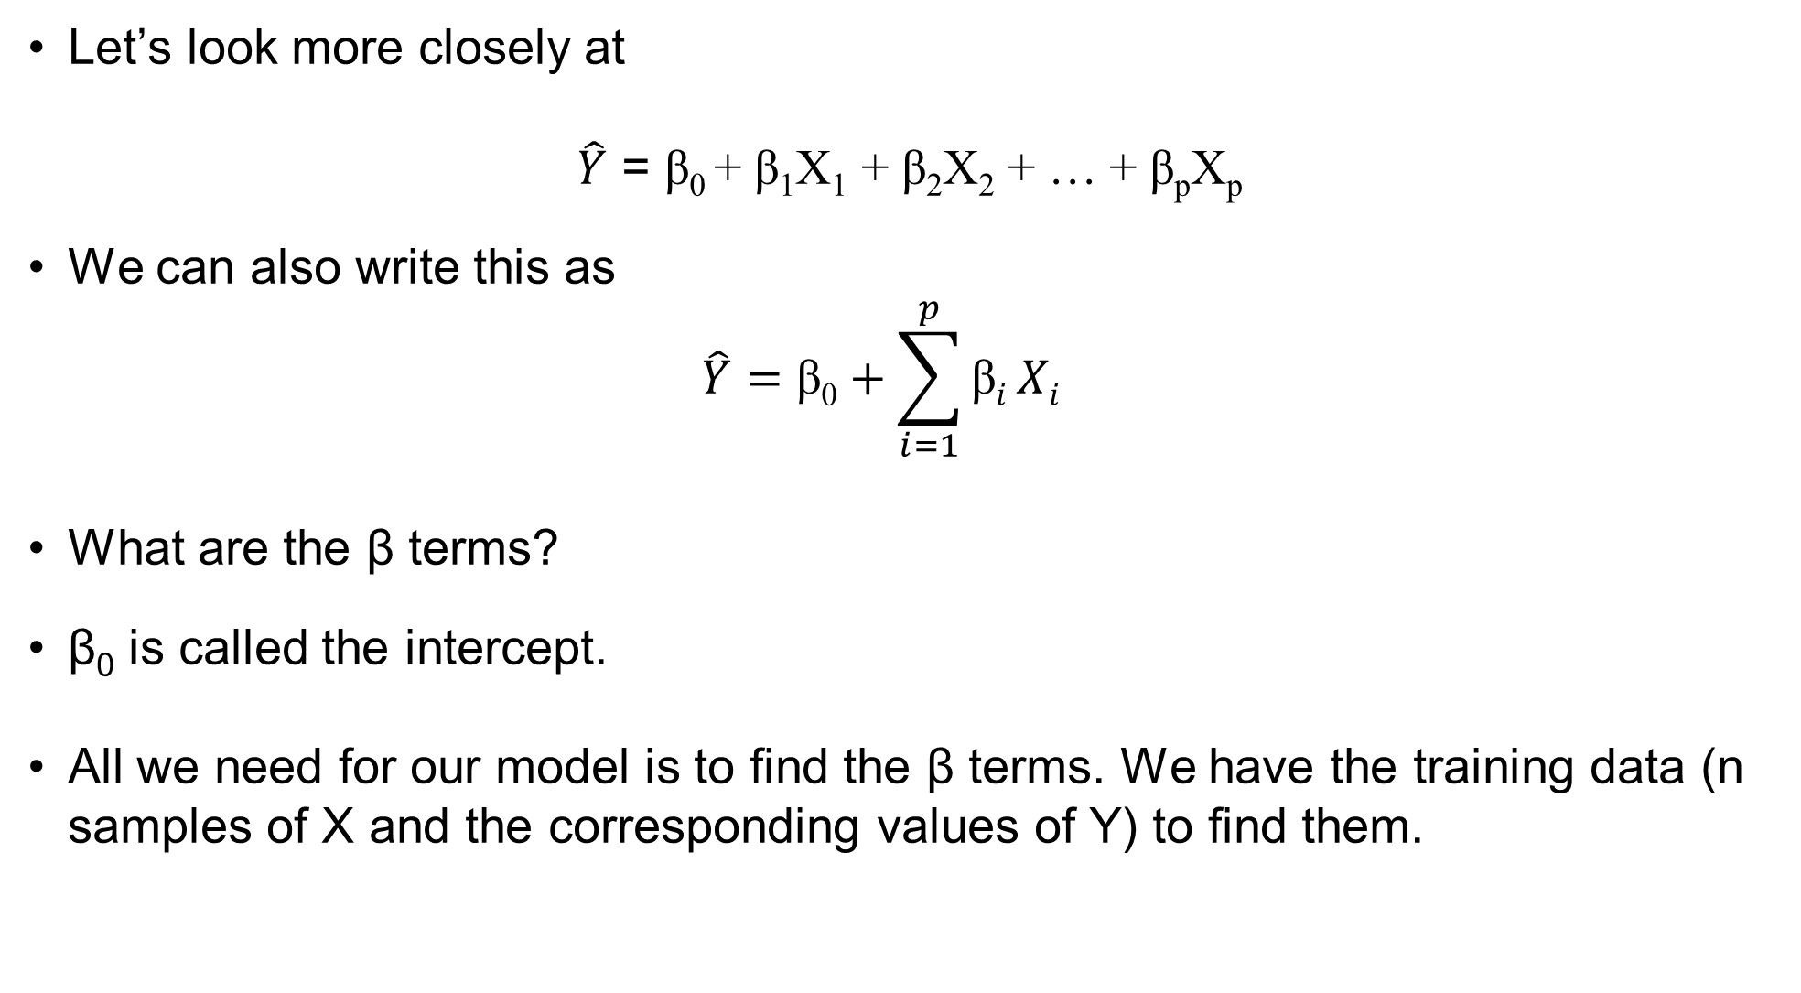
Linear Prediction
Let’s look more closely at
$\hat{Y}$ = β₀ + β₁X₁ + β₂X₂ + … + β_{p}X_{p}
We can also write this as
$$\hat{Y}=\text{β}\text{0}+\sum_{i=1}^{p}{\text{β}i}Xi$$
What are the β terms?
β₀ is called the intercept.
All we need for our model is to find the β terms. We have the training data (n samples of X and the corresponding values of Y) to find them.

Slide 38
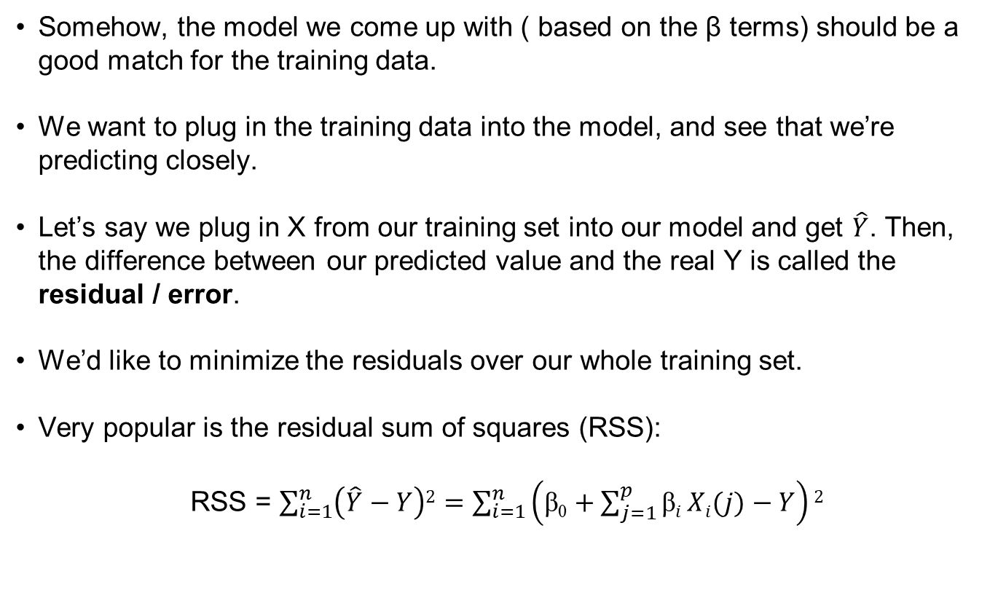
Linear Prediction
Somehow, the model we come up with ( based on the β terms) should be a good match for the training data.
We want to plug in the training data into the model, and see that we’re predicting closely.
Let’s say we plug in X from our training set into our model and get $\hat{Y}$. Then, the difference between our predicted value and the real Y is called the residual / error.
We’d like to minimize the residuals over our whole training set.
Very popular is the residual sum of squares (RSS):
RSS = $\sum_{i=1}^{n}{\left(\hat{Y}−Y\right)2}=$ $\sum_{i=1}^{n}{\left(\text{β}\text{0}+\sum_{j=1}^{p}{\text{β}i}Xi(j)−Y\right)2}$

Slide 39
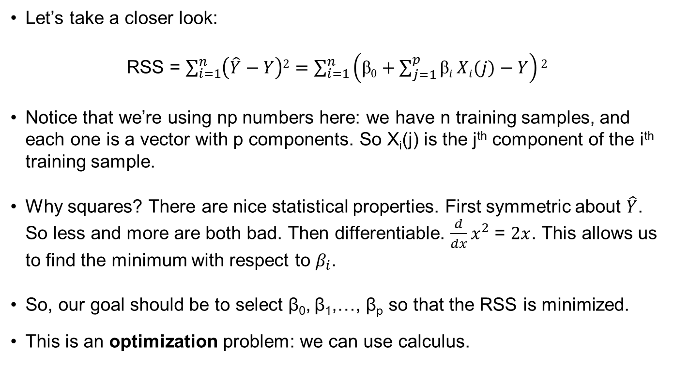
Linear Prediction
Let’s take a closer look:
RSS = $\sum_{i=1}^{n}{\left(\hat{Y}−Y\right)2}=$ $\sum_{i=1}^{n}{\left(\text{β}\text{0}+\sum_{j=1}^{p}{\text{β}i}Xi(j)−Y\right)2}$
Notice that we’re using np numbers here: we have n training samples, and each one is a vector with p components. So X_{i}(j) is the j^{th} component of the i^{th} training sample.
Why squares? There are nice statistical properties. First symmetric about $\hat{Y}$. So less and more are both bad. Then differentiable. ${\frac{d}{dx}x}^{2}$ = $2x$. This allows us to find the minimum with respect to $β_{i}$.
So, our goal should be to select β₀, β₁,…, β_{p} so that the RSS is minimized.
This is an optimization problem: we can use calculus.

Slide 40
Little bit of matrices/calculus
OK, so the RSS above looked scary. Let’s use some vectors to make it look nice:
Make Y a vector (y₁,…,y_{N})^{T}. Then, make X a matrix that is N x p. Also, set β = (β₀, β₁,…, β_{p})^{T}. Then, we can write the RSS above in the simple notation:
RSS = (y-Xβ)^{T}(y-Xβ)
Since we want to minimize the RSS, we can take the derivative and set it to 0. We get
X^{T}(y-Xβ)=0
Solving,
β =(X^{T}X)⁻¹X^{T}y

Slide 41
Linear classification
Let’s look at a classification example.
We want to define a linear boundary that is our best estimate of the regions where each class belongs.
Our linear separator is just a line in the XY plane; if a point is above it, we classify it as orange. If it’s below, we classify it as blue.
There are two parts here:
The equation of the line separating the two classes is chosen usually to correctly classify most points.
Misclassified points give some residual training error.
Y > X+1
Line Y=X+1
Y < X+1

Slide 42
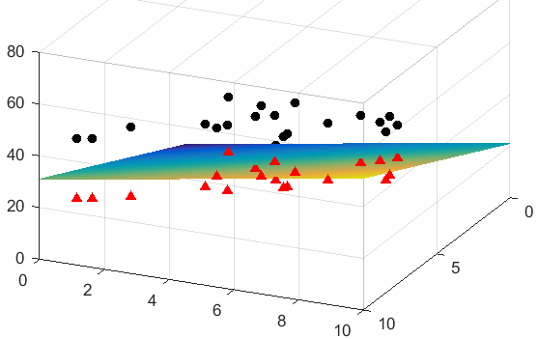
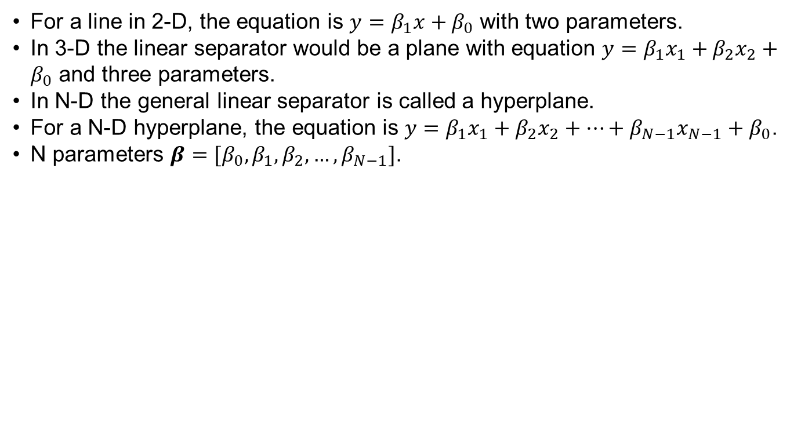
Classification in Higher Dimensions
For a line in 2-D, the equation is $y=β_{1}x+β_{0}$ with two parameters.
In 3-D the linear separator would be a plane with equation $y=β_{1}x_{1}+β_{2}x_{2}+β_{0}$ and three parameters.
In N-D the general linear separator is called a hyperplane.
For a N-D hyperplane, the equation is $y=β_{1}x_{1}+β_{2}x_{2}+…+β_{N−1}x_{N−1}+β_{0}$.
N parameters $β=[β_{0},β_{1},β_{2},…, β_{N−1}]$.
Fig: A linear boundary in three dimensions separating two classes, red and black.

Slide 43
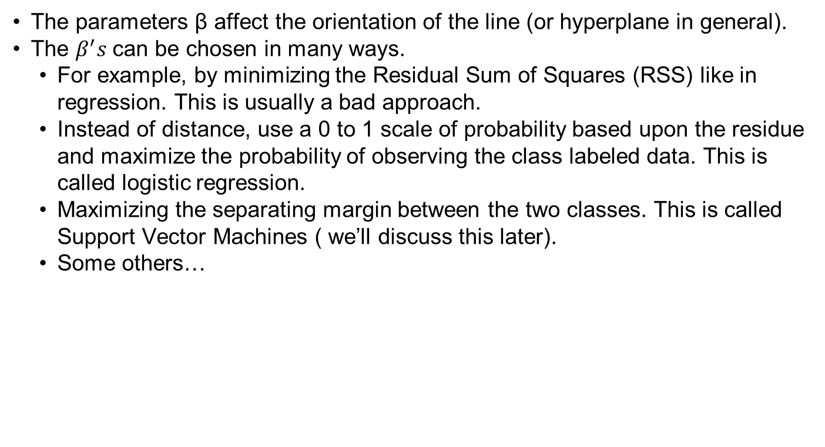

How to choose parameters $β$
The parameters β affect the orientation of the line (or hyperplane in general).
The $β^{′}s$can be chosen in many ways.
For example, by minimizing the Residual Sum of Squares (RSS) like in regression. This is usually a bad approach.
Instead of distance, use a 0 to 1 scale of probability based upon the residue and maximize the probability of observing the class labeled data. This is called logistic regression.
Maximizing the separating margin between the two classes. This is called Support Vector Machines ( we’ll discuss this later).
Some others…

Slide 44
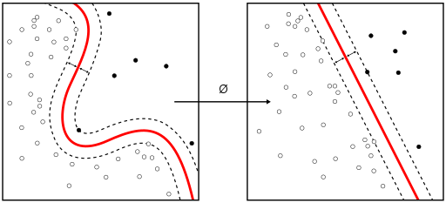
Non-linear classification methods
Sometimes linear classifiers do not give good enough accuracy.
We have many non-linear classifiers that we can resort to. Out of the infinitely many non-linear classifiers you can make, the following are especially popular
Kernel methods (kernel SVM, kernel Principal Component Analysis)
Nearest neighbor method (we will study this)
Decision tree
Neural networks
Fig: Kernel trick of transforming non-linear boundary into a linear boundary in a higher dimensional space.
Source: Wikipedia

Slide 45
Nearest neighbor methods for Classification
Let’s go back to our orange/blue classification.
What if we drop the whole “linear” condition for our model?
We can try to predict class of a point based on the class of points that lie “near” it.
This technique is called the nearest neighbors.
Let’s say for a new point P, we pick the k nearest neighbors, and take the majority vote for the class label.
If majority neighbors belong to Class 0, then a new point is classified to Class 0, and vice-versa.

Slide 46
K-Nearest Neighbors
Example: For every bit of area in the square, we evaluate what is the class of majority of my k=15 neighbors?
Decision boundary is not a nice line anymore, it’s a squiggly border. Expected?
How many points from the training set are misclassified compared to linear prediction?

Slide 47
K-Nearest Neighbors
Let’s say we look at only one closest neighbor for decision.
What does this mean? Well, each point is the same color as the nearest training point.
How much misclassification of training data is there?
Will this scheme cause a problem if used?

Slide 48
Linear versus nearest neighbors
So what’s the difference between these two approaches?
Linear makes many assumptions about problem structure (linearity!)
But it’s stable – remember our simple decision boundary
K-nearest neighbors doesn’t have strict assumptions about the problem
Very unstable predictions though!
In general, we have to figure out something about the problem before we know which ML algorithm is appropriate.
These two algorithms are very fundamental, but there are tons of others also.

Slide 49
Support Vector Machines
Which separating hyperplane is better?

Slide 50
Support Vector Machines
Sometimes there are multiple linear classifiers.
The most robust classifier will be one that maximally separates the data.
We want a classifier that has the maximum margin.
Margin = perpendicular distance of a point to the hyperplane.

Slide 51
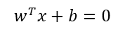
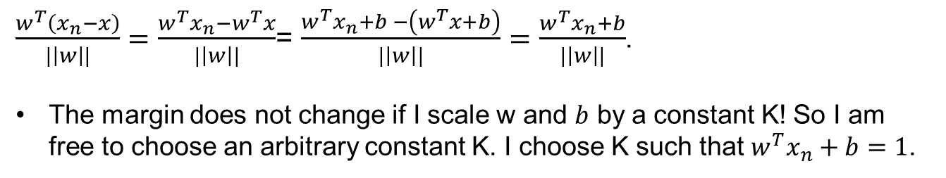
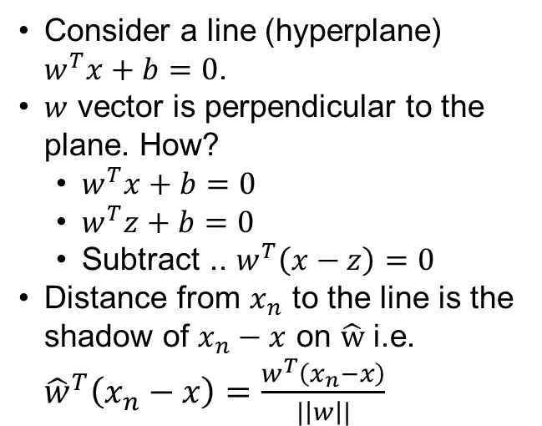
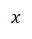

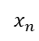
Support Vector Machines
Consider a line (hyperplane) $w^{T}x+b=0$.
$w$ vector is perpendicular to the plane. How?
$w^{T}x+b=0$
$w^{T}z+b=0$
Subtract .. $w^{T}\left(x−z\right)=0$
Distance from $x_{n}$ to the line is the shadow of $x_{n}−x$ on $\hat{w}$ i.e. ${\hat{w}}^{T}\left(x_{n}−x\right)=\frac{w^{T}\left(x_{n}−x\right)}{|\left|w\right||}$
$$w^{T}x+b=0$$
$$\hat{w}$$
z
$x$
$$x_{n}$$
$\frac{w^{T}\left(x_{n}−x\right)}{|\left|w\right||}=\frac{w^{T}x_{n}−w^{T}x}{|\left|w\right||}$= $\frac{w^{T}x_{n}+b −\left(w^{T}x+b\right)}{|\left|w\right||}=\frac{w^{T}x_{n}+b}{|\left|w\right||}$.
The margin does not change if I scale w and $b$ by a constant K! So I am free to choose an arbitrary constant K. I choose K such that $w^{T}x_{n}+b=1$.

Slide 52
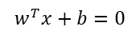
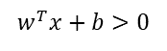
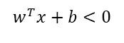
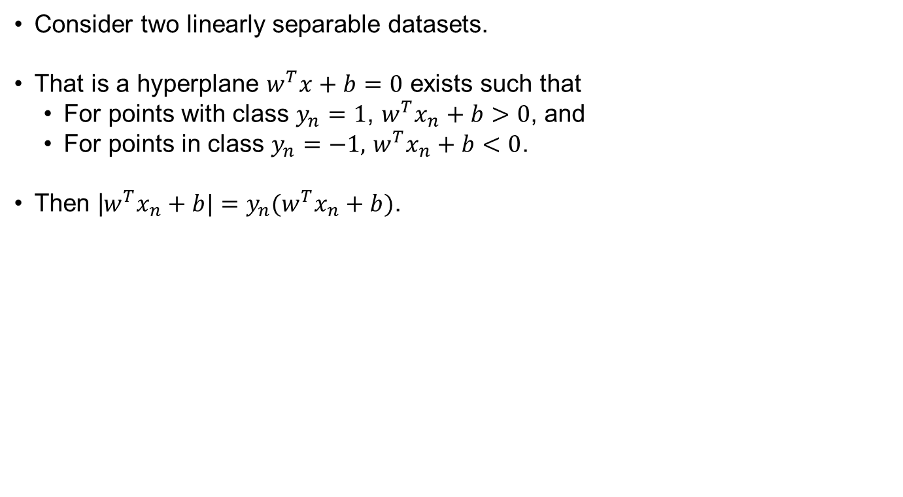

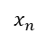
Support Vector Machines
Consider two linearly separable datasets.
That is a hyperplane $w^{T}x+b=0$ exists such that
For points with class $y_{n}=1$, $w^{T}x_{n}+b>0$, and
For points in class $y_{n}=−1,$ $w^{T}x_{n}+b<0$.
Then |$w^{T}x_{n}+b|=y_{n}(w^{T}x_{n}+b)$.
$$w^{T}x+b>0$$
$$w^{T}x+b<0$$
$$\hat{w}$$
z
$x$
$$x_{n}$$
$$w^{T}x+b=0$$

Slide 53
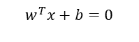
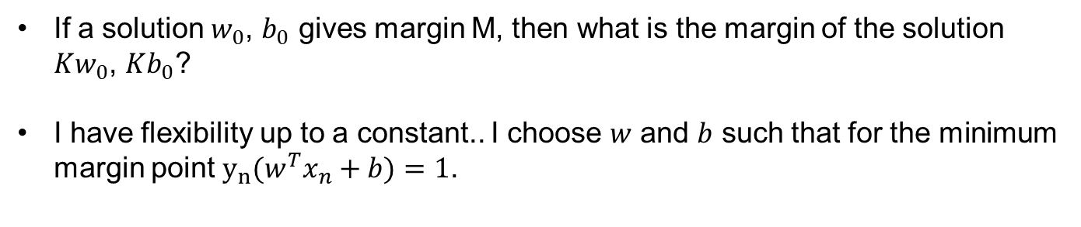
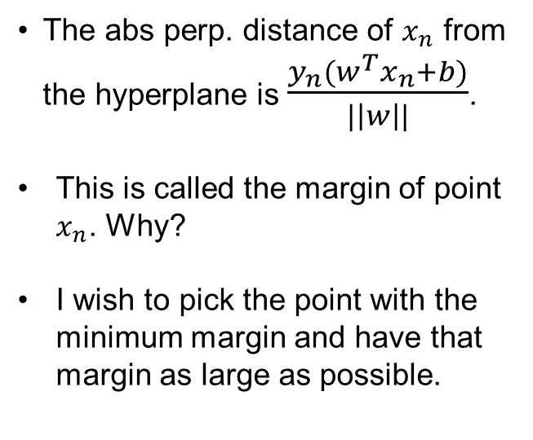
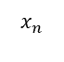
Support Vector Machines: Margin
The abs perp. distance of $x_{n}$ from the hyperplane is $\frac{y_{n}(w^{T}x_{n}+b)}{|\left|w\right||}$.
This is called the margin of point $x_{n}$. Why?
I wish to pick the point with the minimum margin and have that margin as large as possible.
$$\hat{w}$$
z
$x$
$$x_{n}$$
$$w^{T}x+b=0$$
Min margin
If a solution $w_{0}$, $b_{0}$ gives margin M, then what is the margin of the solution $Kw_{0}$, $Kb_{0}$?
I have flexibility up to a constant.. I choose $w$ and $b$ such that for the minimum margin point $y_{n}(w^{T}x_{n}+b)=1$.

Slide 54
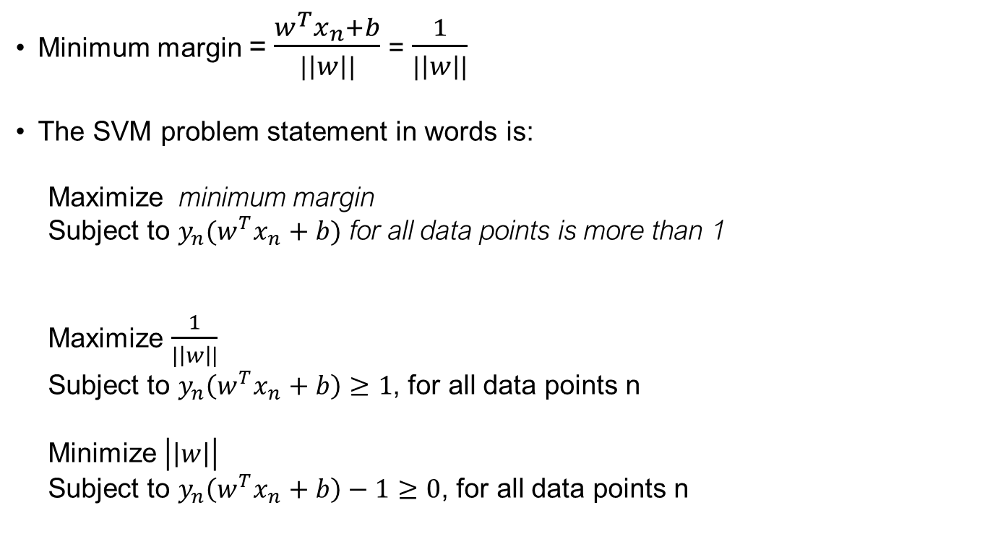
SVM Problem Statement
Minimum margin = $\frac{w^{T}x_{n}+b}{|\left|w\right||}$ = $\frac{1}{|\left|w\right||}$
The SVM problem statement in words is:
Maximize minimum margin
Subject to $y_{n}(w^{T}x_{n}+b)$ for all data points is more than 1
Maximize $\frac{1}{|\left|w\right||}$
Subject to $y_{n}\left(w^{T}x_{n}+b\right)≥1$, for all data points n
Minimize $\left|\left|w\right|\right|$
Subject to $y_{n}\left(w^{T}x_{n}+b\right)−1≥0$, for all data points n

Slide 55
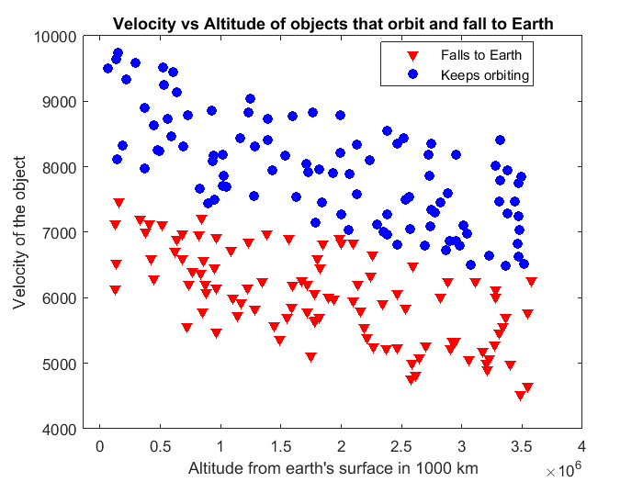
SVM Example with Code

Slide 56
Extending SVM to non-separable data
Equation here
margin=1
margin<0
0<margin<1

Slide 57
Bayesian Classifiers
Before we talk about one more type of classifier, we need some background from probability
Notice the big connection between machine learning and ideas from statistics and probability!
We need a concept called conditional probability. If A and B are events, the conditional probability of A given B is called P(A|B) and is given by
P(A|B) = P(A and B)/P(B)
(this is called Bayes’ rule)
Let’s try an example. If we’re rolling a normal die, let’s let A be the event we roll a 2 and B be the event we roll an even number.
What are P(A), P(B), P(A and B), and P(A|B)?

Slide 58
Bayesian Classifiers
Back to ML problems. Let’s say we’re trying to classify input X=(X₁,…,X_{p}) as being in one of the classes G₁, G₂, …, G_{k}.
We should consider what’s the most likely G that X can belong to.
If we know that G_{k} is the correct output, what’s the probability we get X?
Answer: P(X|G_{k})
This is hard to compute, since X=(X₁,…,X_{p}). Let’s make the assumption these are all (conditionally) independent! (Not necessarily a smart assumption -> naïve Bayes classifier.)
Then, P(X|G_{k}) = P(X₁|G_{k})P(X₂|G_{k}) … P(X_{p}|G_{k}).
So, to classify X, let’s look at P(G₁)*P(X|G₁), P(G₂)*P(X|G₂), …, and pick the largest one!

Slide 59
Naïve Bayes Classifier
So, to classify X, let’s look at P(G₁)*P(X|G₁), P(G₂)*P(X|G₂), …, and pick the largest one!
Basically, we’re picking the most likely class to produce X.
Simple, but we still need to compute P(X₁|G_{k}) and so on.
This is the theme of our mini-projects.

Slide 60
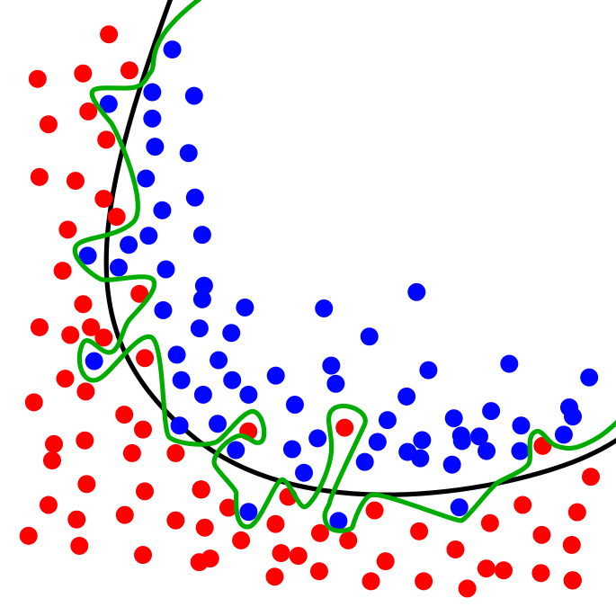

Machine Learning Pitfall: Overfitting/ Underfitting.
If your model has too many parameters but not enough training data, you risk overfitting or bad generalization performance.
Overfitting means your training error will be very low but error on new data will be high.
On the other hand, your model may be too simplistic and you may have high training and test error. With practice you learn to recognize both and find the right complexity of model.
Splitting examples into test set and training set is very important.

Slide 61
In This Lecture
What is Machine Learning?
Related Mathematical Fields
Types of Learning
Applications / Real-Life Examples
Overview of Various Approaches
Detailed View of a Few Approaches
Project

Slide 62
Mini-Project 1: language classification
We will implement a text classifier that predicts whether text is in Spanish or French.
1. You are given two sets of training data: french.txt and spanish.txt.
2. You must implement a python function that reads the training files and splits them up into separate words:
def train(training_set)
3. You should return a dictionary, which contains keys and values. The keys are words and the values will be their frequency in the training set. So, if “beaucoup” appears in the French training set 4 times, the dictionary should have the pair (beaucoup, 4). Also store the total # of words.

Slide 63
Mini-Project 1: language classification
We will implement a text classifier that predicts whether text is in Spanish or French.
4. You must implement the following classification function:
def classify(input_phrase)
5. It should return either 0 (for French) or 1 (for Spanish). The input is a phrase. To test your classifier, try the following: “Faut-il aller au restaurant aujourd'hui?" Also, try the single word « vive ».
6. Once your project is working with these tiny training sets, download a large number of French and Spanish phrases and generate a big training set (try to get 10,000 phrases at least).
7. Test your classifier with another large set of phrases (that you know are either French or Spanish; you can use online news, for example.) What is your probability of misclassification?

Slide 64
Mini-Project 1: language classification
Hints:
You will have to compute probabilities such as P(X₁|G_{k}) (what are X₁ and G_{k} here?) To compute the probability of a word conditioned on the language being French, you can use the following rule:
P(word|French) = (# of copies of word in French training set + 1) / (# of words in training set + 1)
Question: why did we add 1 in the numerator and denominator?s
To find the overall probability of a phrase, multiply the word probabilities. (They aren’t really independent, but we’ll assume that for this project. ) Remember that logs can turn multiplications into additions.

Slide 65
Mini-Project 2: handwritten digit classification
Use naïve Bayes classifier again (just like we did for the last project).
You are provided with labeled training images. These are in the files “trainingimages” and “traininglabels”. Credit: cs188 at Berkeley.
Each image is a 28x28 grid of pixels. Dark (written to) pixels are labeled with “+” or “#”. (“+” is gray and “#” is black, but we’ll ignore this.)
Your training function should read the training files and produce 10 matrices (one for each of the digits 0,1,…,9). Each matrix should be 25x25. Each position is the # of times that pixel was dark in the corresponding training data.
Ex: if there are 400 “9”s in the training data, and the pixel at position (12,19) is dark in 373 of them, your matrix corresponding to “9” should have 373 at that position. Also store the value of 400.

Slide 66
Mini-Project 2: handwritten digit classification
To classify a new image X, realize that Pixel i,j of X can be either dark or light. Let us say the value of the Pixel is X(i,j). We compute the following probabilities, similar to our previous project:
Pr(G_{i})*Pr(X|G_{i}) =
Pr(G_{i})*Pr(Pixel 1,1 = X(1,1) |G_{i})*Pr(Pixel 1,2 = X(1,2) |G_{i}) * … * Pr(Pixel 25,25 = X(25,25) |G_{i})
Here X(i,j) = dark or light and G_{i} for i=0,…,9 is the digit being written to.
To get Pr(Gi), divide the # of digits representing i in the training set by total # of digits.
Pr(Pixel j,k = dark | G_{i}) = (# of times pixel j,k dark in training images labeled i + 1)/ (total # of training images labeled i +1)
Pr(Pixel j,k = light | Gi) = 1- Pr(Pixel j,k = dark).
Finally, for whichever i gives the largest Pr(G_{i})*Pr(X|G_{i}), classify the image as digit i.

Slide 67
References
Textbook: Elements of Statistical Learning, 2nd Edition. Available: http://statweb.stanford.edu/~tibs/ElemStatLearn/
Textbook: Introduction to Machine Learning by Alex Smola. Available: alex.smola.org/drafts/thebook.pdf
Naive Bayes Classifiers: https://en.wikipedia.org/wiki/Naive_Bayes_classifier
Text classification with Naïve Bayes: https://web.stanford.edu/class/cs124/lec/naivebayes.pdf
Image classification: http://www.clarifai.com/#demo

Slide 68
Links to learn further
https://teachablemachine.withgoogle.com/
A good tutorial on Movie genre classification using Machine Learning and Deep Learning. https://spandan-madan.github.io/DeepLearningProject/
https://medium.com/machine-learning-for-humans/why-machine-learning-matters-6164faf1df12

